Slide 1
Simple Linear Regression
1. review of least squares procedure
2. inference for least squares lines

Slide 2
Introduction
We will examine the relationship between quantitative variables x and y via a mathematical equation.
The motivation for using the technique:
  Forecast the value of a dependent variable (y) from the value of independent variables (x₁, x₂,…x_{k}.).
  Analyze the specific relationships between the independent variables and the dependent variable.

Slide 3
The Model
The model has a deterministic and a probabilistic components
House
Cost
Building a house costs about
$75 per square foot.
House cost = 25000 + 75(Size)
Most lots sell
for $25,000
House size

Slide 4
The Model
However, house cost vary even among same size houses!
Since cost behave unpredictably,
we add a random component.
House
Cost
Most lots sell
for $25,000
House cost = 25000 + 75(Size)
+ ε
House size

Slide 5
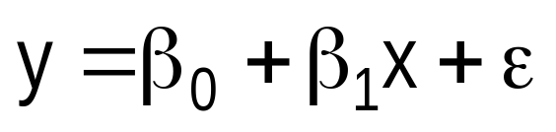
The Model
The first order linear model
  y = dependent variable
  x = independent variable
  β₀ = y-intercept
  β₁ = slope of the line
  ε = error variable
β₀ and β₁ are unknown population
parameters, therefore are estimated
from the data.
y
Rise
β₁ = Rise/Run
β₀
Run
x

Slide 6
Estimating the Coefficients
The estimates are determined by
  drawing a sample from the population of interest,
  calculating sample statistics.
  producing a straight line that cuts into the data.
y
⬥
Question: What should be
considered a good line?
⬥
⬥
⬥
⬥
          
⬥
  
   
⬥
x

Slide 7
The Least Squares (Regression) Line
A good line is one that minimizes
the sum of squared differences between the
points and the line.

Slide 8
The Least Squares (Regression) Line
Sum of squared differences =
(2 - 1)² +
(4 - 2)² +
(1.5 - 3)² +
(3.2 - 4)² = 6.89
Sum of squared differences =
(2 -2.5)² +
(4 - 2.5)² +
(1.5 - 2.5)² +
(3.2 - 2.5)² = 3.99
Let us compare two lines
4
(2,4)
⬥
The second line is horizontal
3
⬥
(4,3.2)
2.5
2
⬥
(1,2)
(3,1.5)
⬥
The smaller the sum of
squared differences
the better the fit of the
line to the data.
1
1
2
3
4

Slide 9
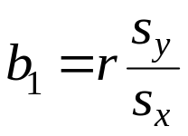
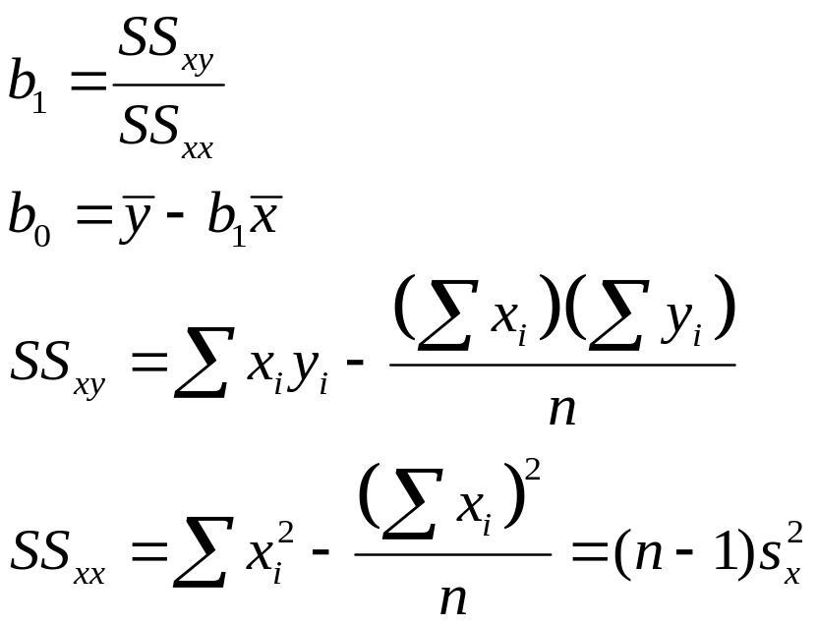
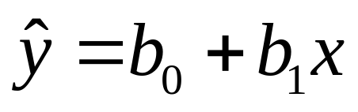
The Estimated Coefficients
Alternate formula for the slope b₁
To calculate the estimates of the slope and intercept of the least squares line , use the formulas:
The regression equation that estimates
the equation of the first order linear model
is:

Slide 10
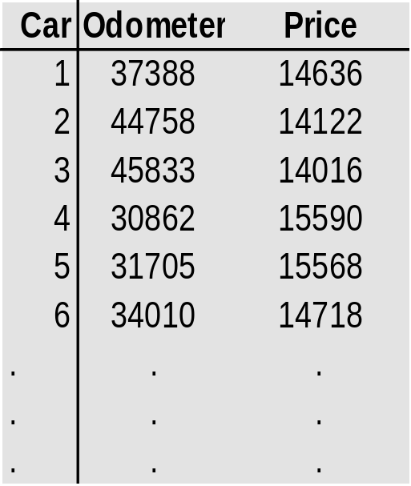
Example:
The Simple Linear Regression Line
  A car dealer wants to find
  the relationship between
  the odometer reading and
  the selling price of used cars.
  A random sample of 100 cars is selected, and the data
  recorded.
  Find the regression line.
Independent
variable x
Dependent
variable y

Slide 11
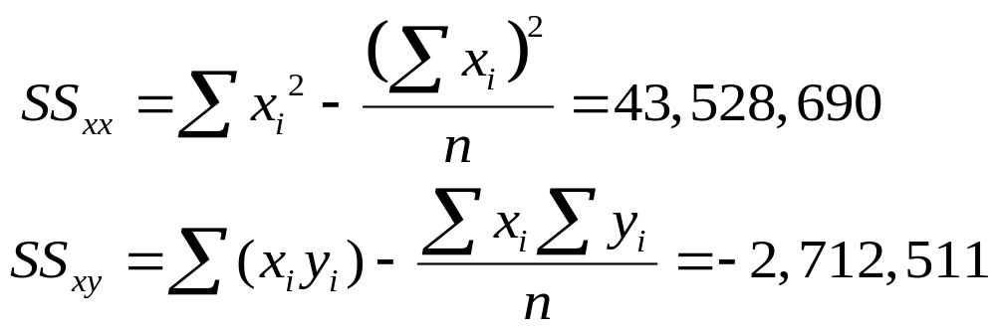
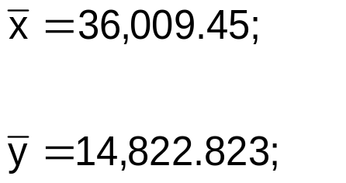
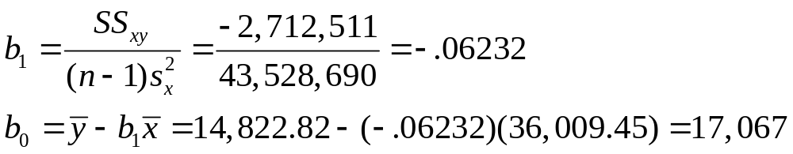
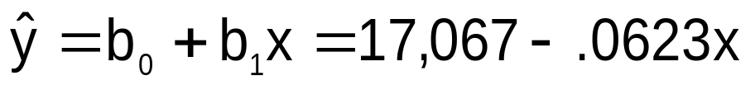
The Simple Linear Regression Line
Solution
  Solving by hand: Calculate a number of statistics
where n = 100.

Slide 12
The Simple Linear Regression Line
Solution – continued
  Using the computer
1. Scatterplot
2. Trend function
3. Tools > Data Analysis > Regression

Slide 13
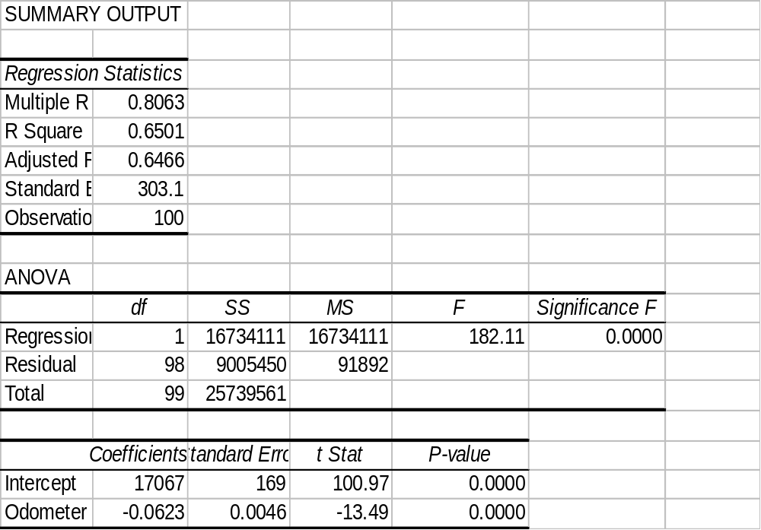

The Simple Linear Regression Line

Slide 14
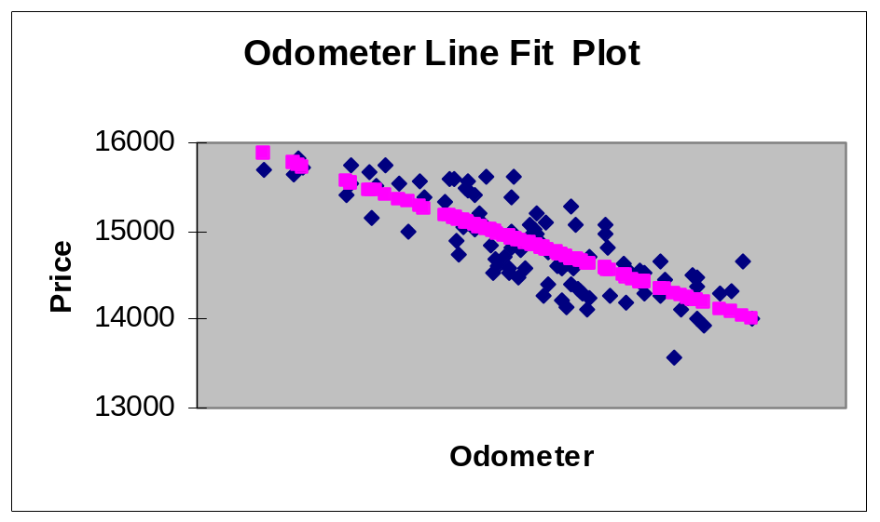

Interpreting the Linear Regression -Equation
17067
0
No data
The intercept is b₀ = $17067.
This is the slope of the line.
For each additional mile on the odometer,
the price decreases by an average of $0.0623
Do not interpret the intercept as the
“Price of cars that have not been driven”

Slide 15
Error Variable: Required Conditions
The error ε is a critical part of the regression model.
Four requirements involving the distribution of ε must be satisfied.
  The probability distribution of ε is normal.
  The mean of ε is zero: E(ε) = 0.
  The standard deviation of ε is σ_{ε} for all values of x.
  The set of errors associated with different values of y are all independent.

Slide 16
The Normality of ε
but the mean value changes with x
E(y|x₃)
β₀ + β₁x₃
μ₃
From the first three assumptions we have:
y is normally distributed with mean
E(y) = β₀ + β₁x, and a constant standard deviation σ_{ε}
E(y|x₂)
β₀ + β₁x₂
μ₂
E(y|x₁)
β₀ + β₁x₁
μ₁
x₁
x₂
x₃
The standard deviation remains constant,

Slide 17
Assessing the Model
The least squares method will produces a regression line whether or not there is a linear relationship between x and y.
Consequently, it is important to assess how well the linear model fits the data.
Several methods are used to assess the model. All are based on the sum of squares for errors, SSE.

Slide 18
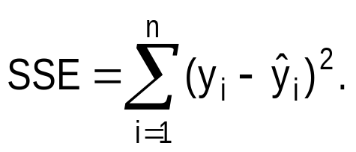
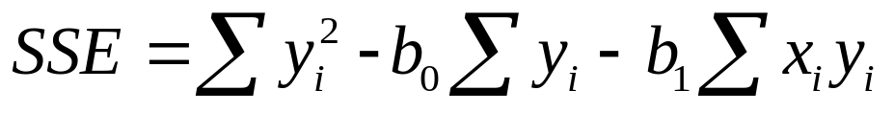
Sum of Squares for Errors
  This is the sum of differences between the points and the regression line.
  It can serve as a measure of how well the line fits the data. SSE is defined by
  A shortcut formula

Slide 19
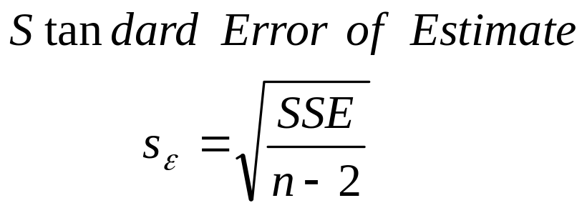
Standard Error of Estimate
  The mean error is equal to zero.
  If σ_{ε} is small the errors tend to be close to zero (close to the mean error). Then, the model fits the data well.
  Therefore, we can, use σ_{ε} as a measure of the suitability of using a linear model.
  An estimator of σ_{ε} is given by s_{ε}

Slide 20
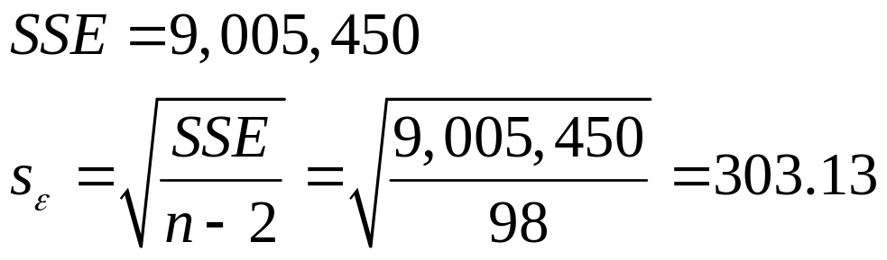

Standard Error of Estimate,
Example
Example:
  Calculate the standard error of estimate for the previous example and describe what it tells you about the model fit.
Solution
It is hard to assess the model based
on s_{ε} even when compared with the
mean value of y.

Slide 21
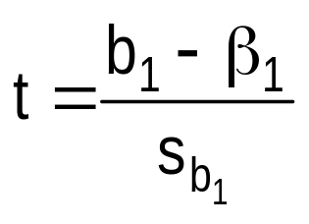
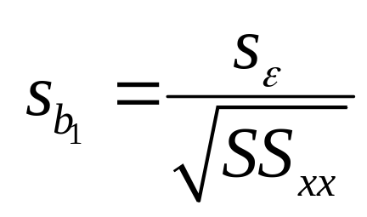
Testing the Slope
We can draw inference about β₁ from b₁ by testing
  H₀: β₁ = 0
  H₁: β₁ = 0 (or < 0,or > 0)
  The test statistic is
  If the error variable is normally distributed, the statistic is Student t distribution with d.f. = n-2.
where
The standard error of b₁.

Slide 22
Testing the Slope,
Example
Example
  Test to determine whether there is enough evidence to infer that there is a linear relationship between the car auction price and the odometer reading for all three-year-old Tauruses in the previous example .
  Use α = 5%.

Slide 23
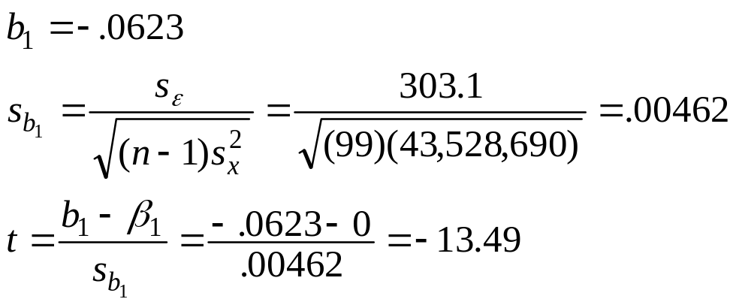
Testing the Slope,
Example
Solving by hand
  To compute “t” we need the values of b₁ and s_{b1}.
  The rejection region is t > t_{.025} or t < -t_{.025} with ν = n-2 = 98.
  Approximately, t_{.025} = 1.984

Slide 24
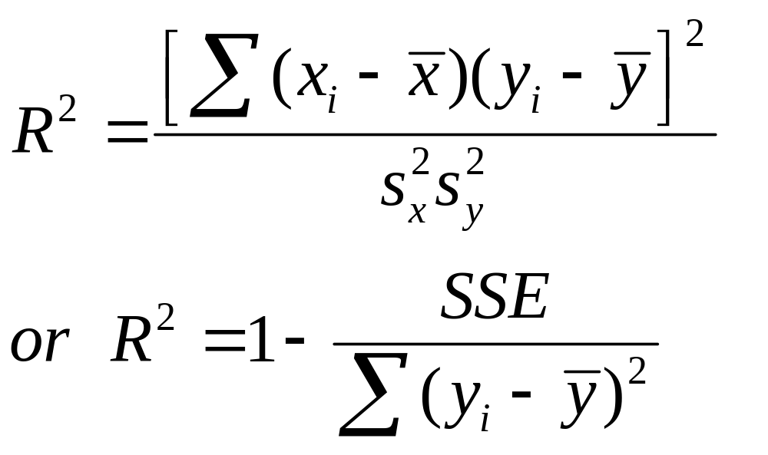
Coefficient of determination
  To measure the strength of the linear relationship we use the coefficient of determination.
Note that the coefficient of determination is r²

Slide 25
Coefficient of determination
To understand the significance of this coefficient note:
The regression model
Explained in part by
Overall variability in y
Remains, in part, unexplained
The error

Slide 26



Coefficient of determination
y₂
Two data points (x₁,y₁) and (x₂,y₂)
of a certain sample are shown.
y
Variation in y = SSR + SSE
y₁
x₁
x₂
Total variation in y =
Variation explained by the
regression line
+ Unexplained variation (error)

Slide 27
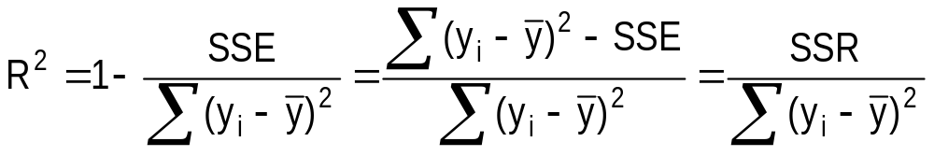
Coefficient of determination
R² measures the proportion of the variation in y that is explained by the variation in x.
R² takes on any value between zero and one.
  R² = 1: Perfect match between the line and the data points.
  R² = 0: There are no linear relationship between x and y.

Slide 28
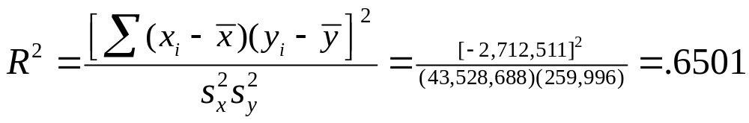
Coefficient of determination,
Example
Example
  Find the coefficient of determination for the used car price –odometer example.what does this statistic tell you about the model?
Solution
  Solving by hand;

Slide 29
Using the Regression Equation
Before using the regression model, we need to assess how well it fits the data.
If we are satisfied with how well the model fits the data, we can use it to predict the values of y.
To make a prediction we use
  Point prediction, and
  Interval prediction

Slide 30
Point Prediction
Example
  Predict the selling price of a three-year-old Taurus with 40,000 miles on the odometer.
A point prediction
  It is predicted that a 40,000 miles car would sell for $14,575.
  How close is this prediction to the real price?

Slide 31
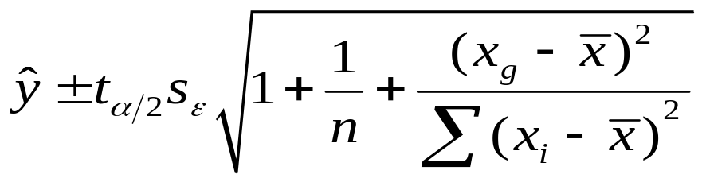
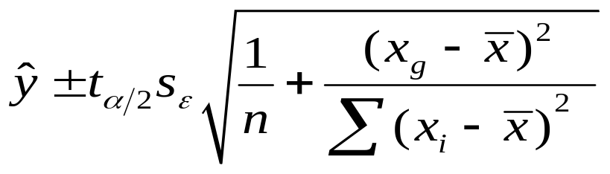
Interval Estimates
Two intervals can be used to discover how closely the predicted value will match the true value of y.
  Prediction interval – predicts y for a given value of x,
  Confidence interval – estimates the average y for a given x.
  The prediction interval
  The confidence interval

Slide 32
Interval Estimates,
Example
Example - continued
  Provide an interval estimate for the bidding price on a Ford Taurus with 40,000 miles on the odometer.
  Two types of predictions are required:
    A prediction for a specific car
    An estimate for the average price per car

Slide 33

Interval Estimates,
Example
Solution
  A prediction interval provides the price estimate for a single car:
t_{.025,98}
_{Approximately}

Slide 34
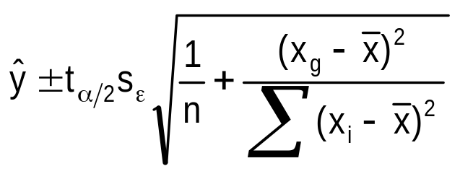
Interval Estimates,
Example
Solution – continued
  A confidence interval provides the estimate of the mean price per car for a Ford Taurus with 40,000 miles reading on the odometer.
    The confidence interval (95%) =

Slide 35

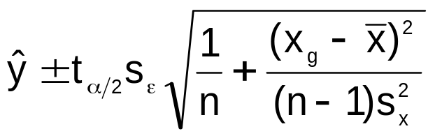

The effect of the given x_{g} on the length of the interval
  As x_{g} moves away from x the interval becomes longer. That is, the shortest interval is found at x.

Slide 36


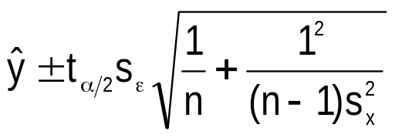




The effect of the given x_{g} on the length of the interval
  As x_{g} moves away from x the interval becomes longer. That is, the shortest interval is found at x.

Slide 37
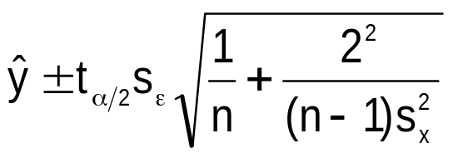




The effect of the given x_{g} on the length of the interval
  As x_{g} moves away from x the interval becomes longer. That is, the shortest interval is found at x.

Slide 38
Regression Diagnostics - I
The three conditions required for the validity of the regression analysis are:
  the error variable is normally distributed.
  the error variance is constant for all values of x.
  The errors are independent of each other.
How can we diagnose violations of these conditions?

Slide 39
Residual Analysis
Examining the residuals (or standardized residuals), help detect violations of the required conditions.
Example – continued:
  Nonnormality.
    Use Excel to obtain the standardized residual histogram.
    Examine the histogram and look for a bell shaped. diagram with a mean close to zero.

Slide 40
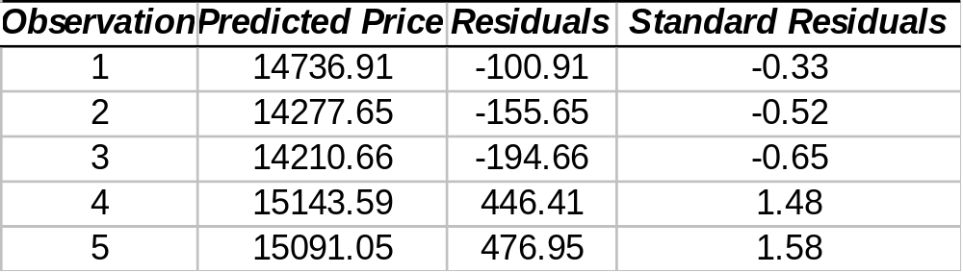
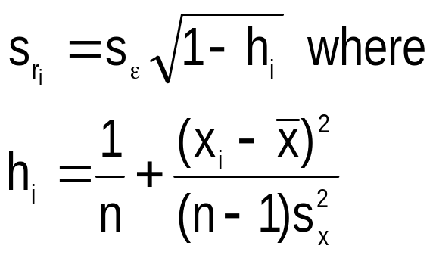
Residual Analysis
A Partial list of
Standard residuals
For each residual we calculate
the standard deviation as follows:
Standardized residual ‘i’ =
Residual ‘i’
Standard deviation

Slide 41
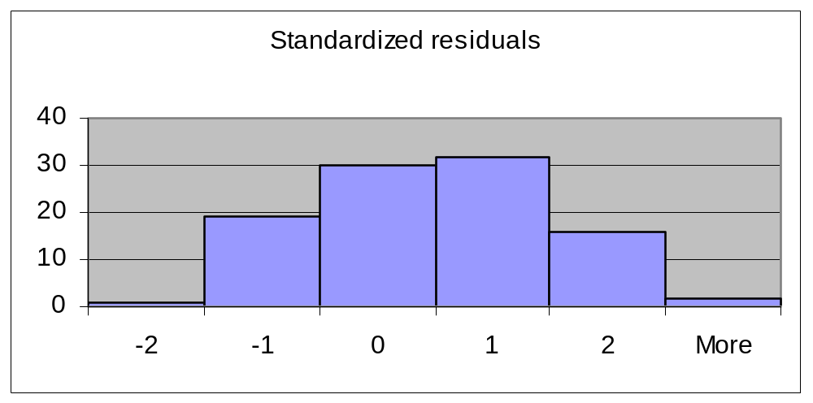
Residual Analysis
It seems the residual are normally distributed with mean zero

Slide 42
Heteroscedasticity
When the requirement of a constant variance is violated we have a condition of heteroscedasticity.
Diagnose heteroscedasticity by plotting the residual against the predicted y.
+
^
y
+
+
Residual
+
+
+
+
+
+
+
+
+
+
+
+
+
+
+
+
+
+
+
+
+
+
+
+
^
+
+
+
+
+
y
+
+
+
+
+
+
+
+
+
+
+
+
+
+
+
^
The spread increases with y

Slide 43
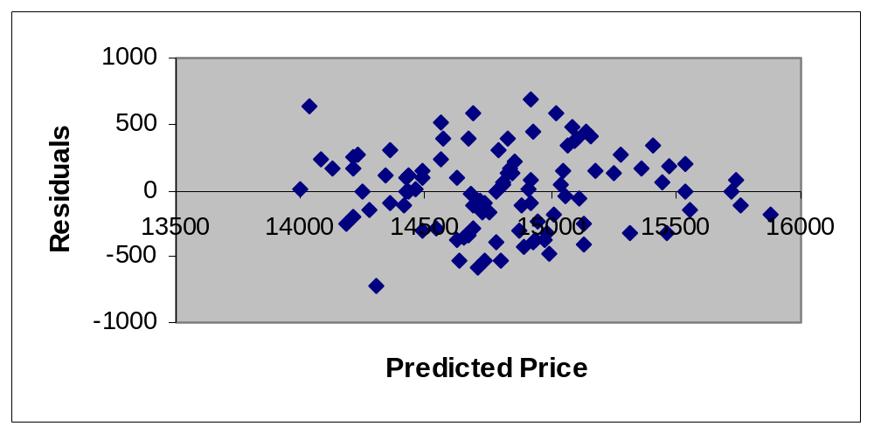
Homoscedasticity
When the requirement of a constant variance is not violated we have a condition of homoscedasticity.
Example - continued

Slide 44
Non Independence of Error Variables
  A time series is constituted if data were collected over time.
  Examining the residuals over time, no pattern should be observed if the errors are independent.
  When a pattern is detected, the errors are said to be autocorrelated.
  Autocorrelation can be detected by graphing the residuals against time.

Slide 45
Non Independence of Error Variables
Patterns in the appearance of the residuals over time indicates that autocorrelation exists.
Residual
Residual
+
+
+
+
+
+
+
+
+
+
+
+
+
0
+
0
+
Time
Time
+
+
+
+
+
+
+
+
+
+
+
+
+
Note the runs of positive residuals,
replaced by runs of negative residuals
Note the oscillating behavior of the
residuals around zero.

Slide 46
Outliers
An outlier is an observation that is unusually small or large.
Several possibilities need to be investigated when an outlier is observed:
  There was an error in recording the value.
  The point does not belong in the sample.
  The observation is valid.
Identify outliers from the scatter diagram.
It is customary to suspect an observation is an outlier if its |standard residual| > 2

Slide 47
An outlier
An influential observation
+
+
+
+
+
+
+
+
+
+
+
+
+
+
… but, some outliers
may be very influential
+
+
+
+
+
+
+
+
+
+
+
+
+
The outlier causes a shift
in the regression line

Slide 48
Procedure for Regression Diagnostics
Develop a model that has a theoretical basis.
Gather data for the two variables in the model.
Draw the scatter diagram to determine whether a linear model appears to be appropriate.
Determine the regression equation.
Check the required conditions for the errors.
Check the existence of outliers and influential observations
Assess the model fit.
If the model fits the data, use the regression equation.

Slide 49
Linear Regression
Practical
https://github.com/reggieag/Linear-Regression-Python/blob/master/linearRegression1.py
https://github.com/reggieag/Linear-Regression-Python/blob/master/linearRegression2.py
https://github.com/reggieag/Linear-Regression-Python/blob/master/readme

Slide 50
Multiple Linear Regression Practical
https://github.com/mahesh147/Multiple-Linear-Regression/blob/master/50_Startups.csv
https://github.com/mahesh147/Multiple-Linear-Regression/blob/master/README.md
https://github.com/mahesh147/Multiple-Linear-Regression/blob/master/multiple_linear_regression.py

